Slide 1
Parental Engagement Report

Slide 2
The following methods were used to compile the report:
Schools visits
Parent Council meetings
Website Analysis
Engagement Survey
Supplementary information was gathered from colleagues that work within ECS

Slide 3
Parent Council Visits
A random selection of Parent Council meetings were attended in May and June. There was a mixture of Primary and Secondary schools as well as a combination of smaller and larger schools.
At these meetings we discussed communication between…
the school and the Parent Forum
the school and the Parent Council
Parent Council Members
Parent councils and other parent councils
The Parent Council the Parent Forum
The Highland Council and the Parent Council
Notes:
School > Parents – Differed from school to school
Improving communication
Parent Council members provided some suggestions when we discussed how we could improve communication between the school and parents. Email
Online Reporting
Websites looking forward they said they would like to see a standard approach for websites across all Highland schools.
Online payments – Almost all the Parent Councils I attended reported that the online payment system for school meals needed improving, parents feel the process is too long, they said they would like to see: a save feature, real time up date and the option to view the balance online.
A number of Parent Councils mentioned that they would like to see more consistency across all schools with how they communicate with parents.
School > Parent Council – PC happy with current communication
Parent Council Members – Happy with how they communicate – email, text, school gate etc.
Communication between Parent Councils and other Parent Councils - more networking opps
Parent Council > Parent Forum – differed from school to school
Some Parent Councils communicate through the school to parents i.e. a section in the school newsletter, a section on the school noticeboard and/or a section on the school website.
Other parent councils communicate independently from the school – a separate newsletter, a separate website.
It was suggested by a few Parent Councils that a centralised email address for Parent Councils would be useful. This would prevent Parent Council members having to share their own personal email address with the parent forum, although many members said they did not mind doing this.
Highland Council > Parent Council
The majority of Parent Councils felt that the communication they received from Highland Council could be improved. They suggested this could be improved by:
More and earlier consultation on important changes
Updating the Parent Council section of the Highland Council website
Providing more opportunity for networking and “sharing good practice” between Parent Councils from different schools
Providing opportunities for the Parent Councils to feedback to the Highland Council
Receiving more training and guidance from the Highland Council. Refresher courses for Office Bearer Roles was suggested
Many of the Councils stated that they would like to see the Highland Council and Schools helping them to raise the profile of Parent Councils within the Parent Forum

Slide 4
Website Analysis
Out of all Highland Schools approximately 154 have a website or blog:
Notes:
In order to create a complete picture of the current arrangement of school websites and blogs across Highland we undertook a website analysis.
Looked at school websites and blogs – HC website and google searches

Slide 5
Website Analysis
There are 5 websites hosted through Glow
88 are hosted on external sites:
Approximately 18 additional sites
15 are unknown
INVERNESS ONLINE
2
WORDPRESS
21
WEEBLY
6
SPANGLEFISH
11
SCHOOLS.IK.ORG
4
HOME SPUN WEB DESIGN
2
JOOMLA
2
AGUMDOO
3
EDUBLOGS
19
Notes:
Looked at where school websites were hosted. Varied. Some had costs attached.

Slide 6
Website Analysis
There are 158 schools with a Highland.sch.uk address
93 of the 158 are live sites:
Out of this there are 38 sites under construction
26 are redirects
67 are not up to date
20 up to date
6 are partially up to date
A total of 101 schools have a link to their school website on the schools section of the Highland Council website.
There are issues surrounding the link 34 of these links do not work, do not take you to the new website or are a redirect.
58 schools do not display a link on the Highland Council website
Notes:
Looked in to schools using highlad.sch.uk addresses.
Links on HC website

Slide 7
Website Analysis Social Media
There are 27 Facebook accounts:
8 up to date or have recent posts
19 are not up dated – no recent posts
There are 14 twitter accounts:
6 have tweeted recently
5 do not have recent tweets
3 cannot tell (protected tweets)
Notes:
No guarantee that these FB accounts are genuine…

Slide 8
Parental Engagement Survey
The aim of this survey was to have a better understand of the requirements of parents for communication and engagement
In total 324 parents and carers completed the survey and responses were received from across 35 different primary and secondary schools
Notes:
The survey was a self-completion questionnaire
Was open to all parents and carers across Highland.
It was available and promoted online via the Highland Councils official Facebook and Twitter pages.
A random selection of schools distributed the questionnaire to parents either electronically or via a paper copy.
Electronic versions were delivered to parents either through an emailed hyperlink or as a link displayed on their school website or blog.
800 paper copies were sent out to five schools who wanted to distribute paper copies, 127 were returned.
The survey was presented in both English and Gaelic.

Slide 9
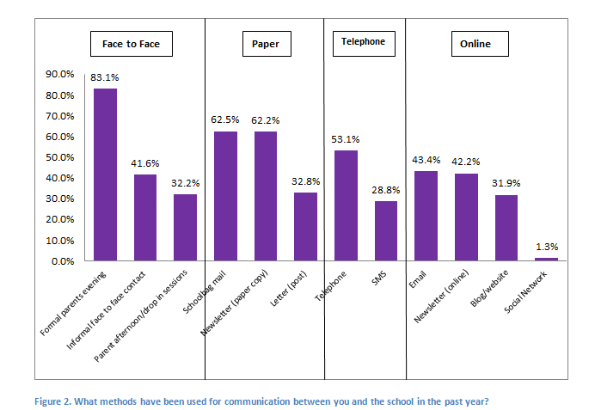
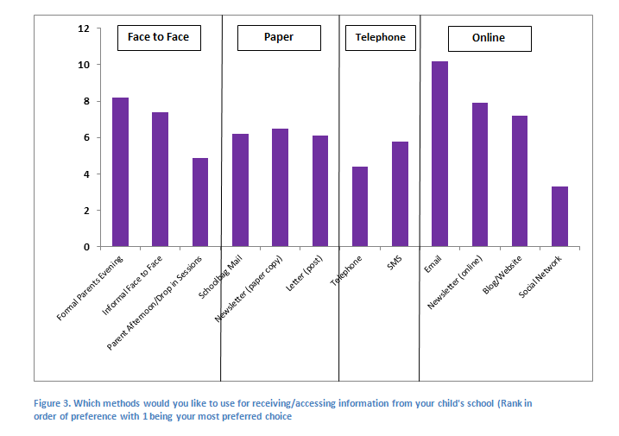
Current methods for accessing and receiving information:
Methods that Parents and Carers would like to use:
Notes:
Formal parents evening was reported as the most common form of current communication with 83.1% parents selecting this answer.
A total of twelve options were provided and the six methods which are most commonly used as reported by parents and carers are:
Formal parents evening
Schoolbag mail
Newsletter (paper)
Telephone
Email
Newsletter (online)
Parents and carers were then asked to rate on a scale of 1 (most preferred) to 12 (least preferred) what methods they would like to use for receiving and accessing information from their child’s school.
Email was rated at the most preferred choice and Social network was the least preferred
The same twelve options that were provided in the previous question were used in this question and the top six methods which were ranked as the most preferred by parents were:
Email
Formal parents evening
Newsletter (online)
Informal face to face
Blog/website
Newsletter paper copy.
This suggests that in general we are communicating with parents via methods which they find effective but there are ways which this can be improved. There are methods which aren’t used primarily for communication which parents have rated highly.
e-mail
online newsletters
school websites

Slide 10
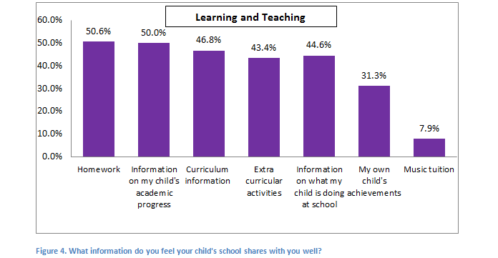
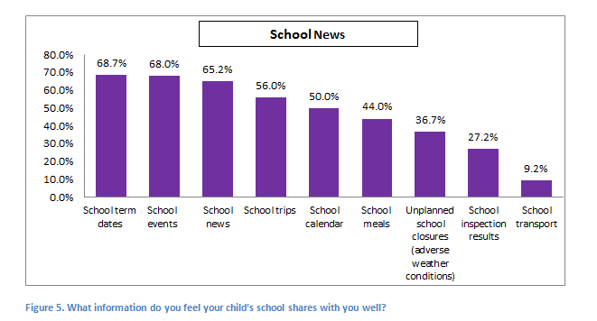
Information which is shared well…..
School term dates
School events
School news
Notes:
School term dates scored the highest with 68.7%.
School events was second with 68%.
School news was third with 65.2%.

Slide 11
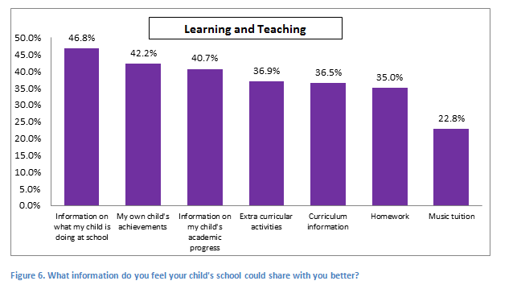
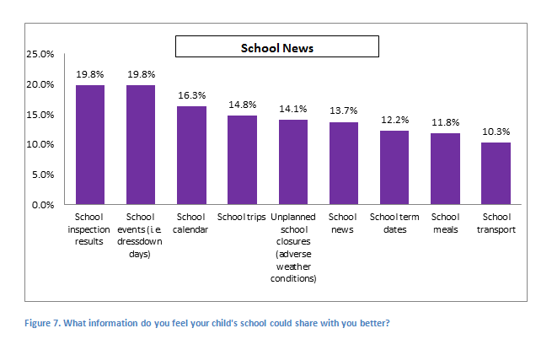
Information that could be shared better…
Information on what my child is doing at school
My own child’s achievements
Information on my child’s academic progress
Notes:
Information on what my child is doing at school scored the highest with 46.8%.
My own child’s achievements was second with 42.2%.
Information on my child’s academic progress was third with 40.7%.
The survey asked how frequently parents and carers would like to receive information from their child’s school. Reponses reported that:
47.1% would like monthly communications
28.3% would like information as and when it becomes available
17.2% opted for weekly
7.2% selected Termly

Slide 12
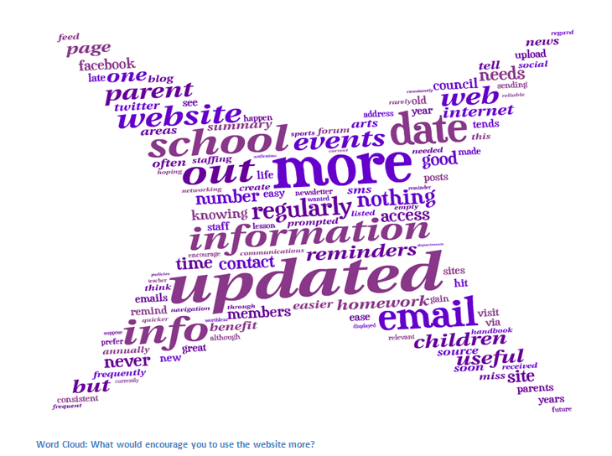
School websites & blogs
Parents and carers were asked how often they visited their child’s school blog if they had one.
17.7% visited weekly or more
21% Visited every few months
8.9% visited once or twice per year
20% almost never visited
20.3% visited monthly
They were then asked what would encourage them to use the school website more…..
Notes:
Parents and carers were asked how often they used the internet. The majority reported they used the internet daily.
We asked parents and carers what would encourage them to use the school website more and we received 68 responses.
Common themes were:
Updated more regularly
More information
If all information was online
Dates
Alerts and notifications to look
Reminded about the website/blog
The survey then asked an open-ended question about what information would be useful on a school website 134 responses were recorded@
General school news
Term dates
Events
Class/department information
School calendar
Extra-curricular activities
Homework

Slide 13
Accessing Information
Parents and carers were asked how they would view information online:
77.5% - Computer
51.6% Tablet/Smartphone – via web broswer
30.3% Tablet/Smartphone – via app
5.3% said they would not want to receive information from their child’s school via an online method
Viewing progress reports online
The survey went on to question whether parents and carers would like to view their child’s progress report online:
72% answered no
28% answered yes
Paying online
Parents were also surveyed on whether or not they would like the option to pay online for school trips, swimming lessons and music tuition.
75.2% said yes
24.8% said no

Slide 14
Parent Councils
Parents and Carers were asked if they knew where to access that contact details of the Parent Council at their child’s school:
62.7% answered yes
37.3% answered no
Parents and Carers were asked if they knew where to access the minutes of the Parent Council meeting.
56.3% stated they did
43.7% stated they did not
Parents and carers were also asked about how they would like to access information from the Parent Council:
68.1% - a section on the school website
39.7%- through the school newsletter

Slide 15
Overall we make the following recommendations:
A project has been approved to take forward the following recommendations.
Websites:
Links on the Highland Council website to School websites
Every school in Highland will have an up to date website
Eliminate all websites that are hosted on old Highland web servers.
Template:
The template will be created in house
Websites template will be compatible with mobile and tablet devices.
Notes:
Links on HC website
All schools, one up to date websites
Supporting schools to have a website – standard template – resource for training for use of websites

Slide 16
Overall we make the following recommendations:
Email
Parents would like Email to be used more for communications.
We will investigate how to facilitate a centralised email address for Parent Councils.
Parent Councils
Parent Councils will have a section on the school website and/or a section in the school newsletter.

Slide 17
Any Questions…

